Slide 1

Heavy quarkonium production in heavy-ion collisions in LHCb
Speaker: Youen Kang
(on behalf of the LHCb collaboration)

Slide 2
Outline
Introduction
Results
Ongoing analysis
Summary and outlook

Slide 3
Introduction

Slide 4
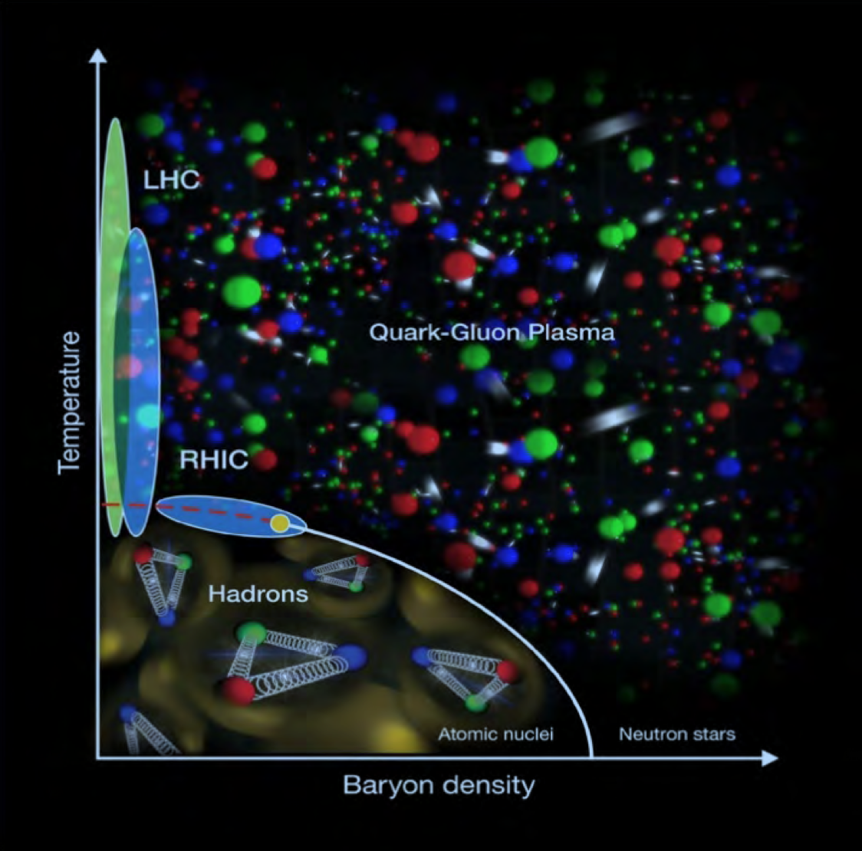
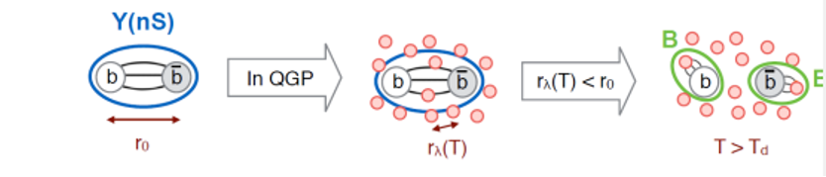
Quark-gluon plasma
Quark-Gluon Plasma (QGP):
A thermally equilibrated system where partons are deconfined
Achieve either by heating or compression of nuclei
Exist in the early stage of universe and ultra-relativistic energy heavy ion collisions (Big&Little Bang)
Color screening:
High density of free color charges leads to color screening and dissociation of heavy quarkonium.
A schematic of QCD phase diagram

Slide 5
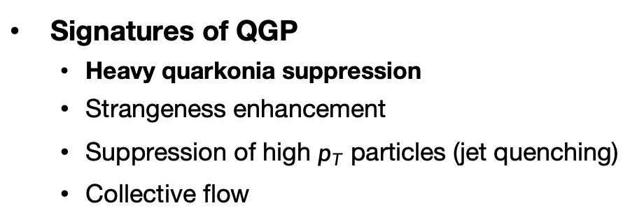
Collision systems and nuclear matter effects
Signatures of QGP
Heavy quarkonia suppression
Strangeness enhancement
Suppression of high $p_{T}$ particles (jet quenching)
Collective flow
Collision systems
A-A collisions: Both Hot Nuclear Matter (HNM) effects (related to the QGP formation and evolution) and Cold Nuclear Matter (CNM) effects exist
p-A collisions: CNM effects dominate
pp collisions: No nuclear matter effect expected to exist
Large systems
Small systems

Slide 6
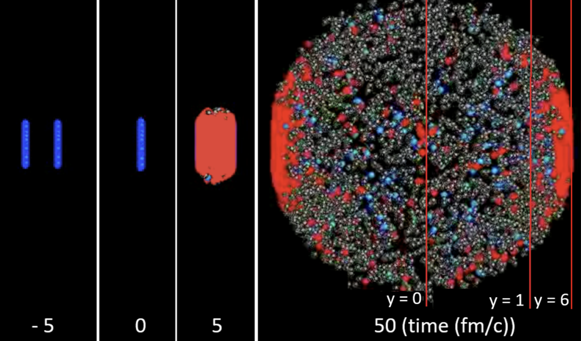
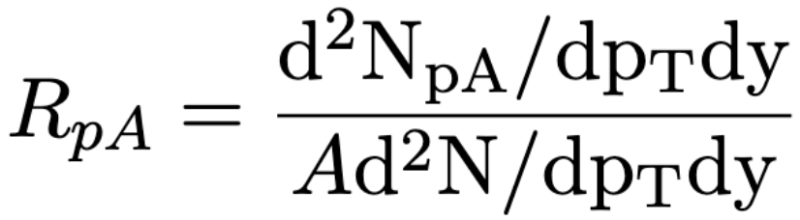
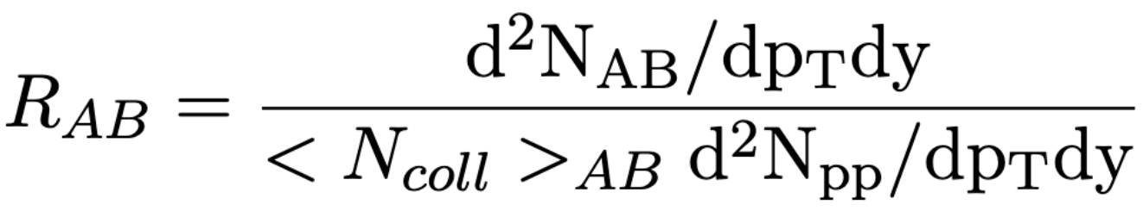
Nuclear modification factor
≠ superpositions of 2A pp collisions
Quantified with nuclear modification factor:

Slide 7
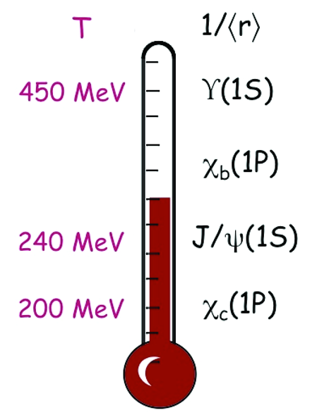
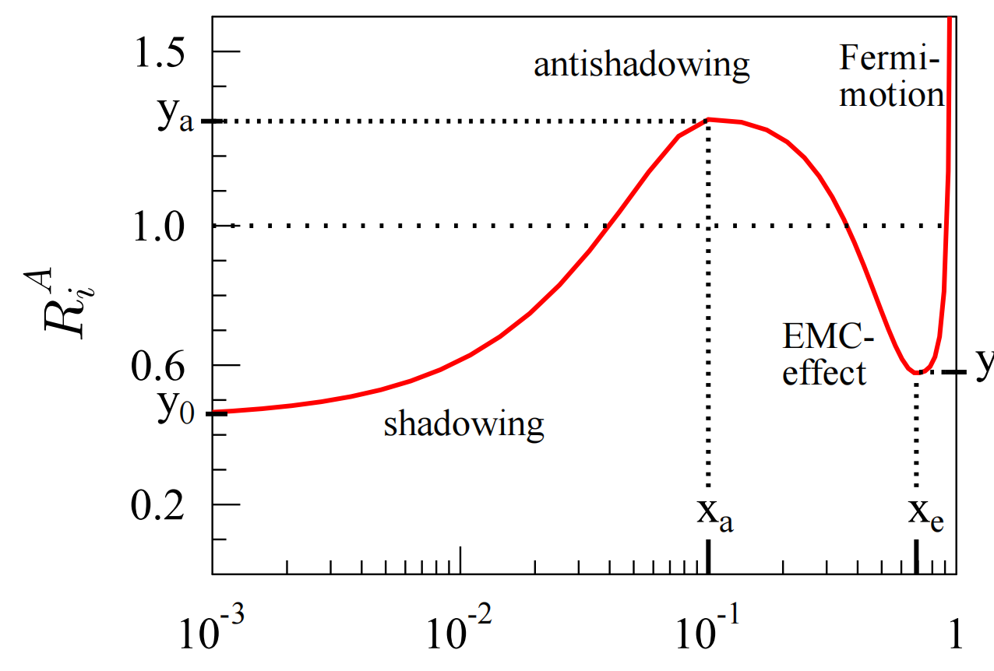
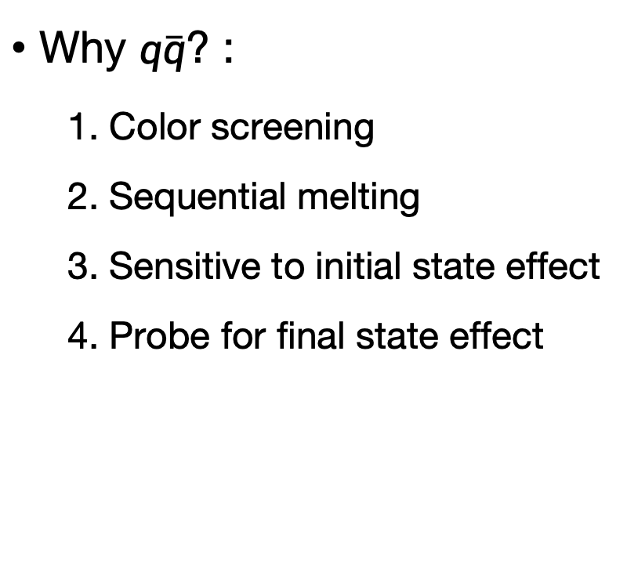
Heavy quarkonium production
Why $q\overline{q}$? :
1. Color screening
2. Sequential melting
3. Sensitive to initial state effect
4. Probe for final state effect
2.
3.
1.
4. Co-mover effect:
‘Quarkonia are suppressed by interaction with the co-moving medium, constituted by particles with similar rapidities.’ [JHEP 03 (2019) 063]

Slide 8
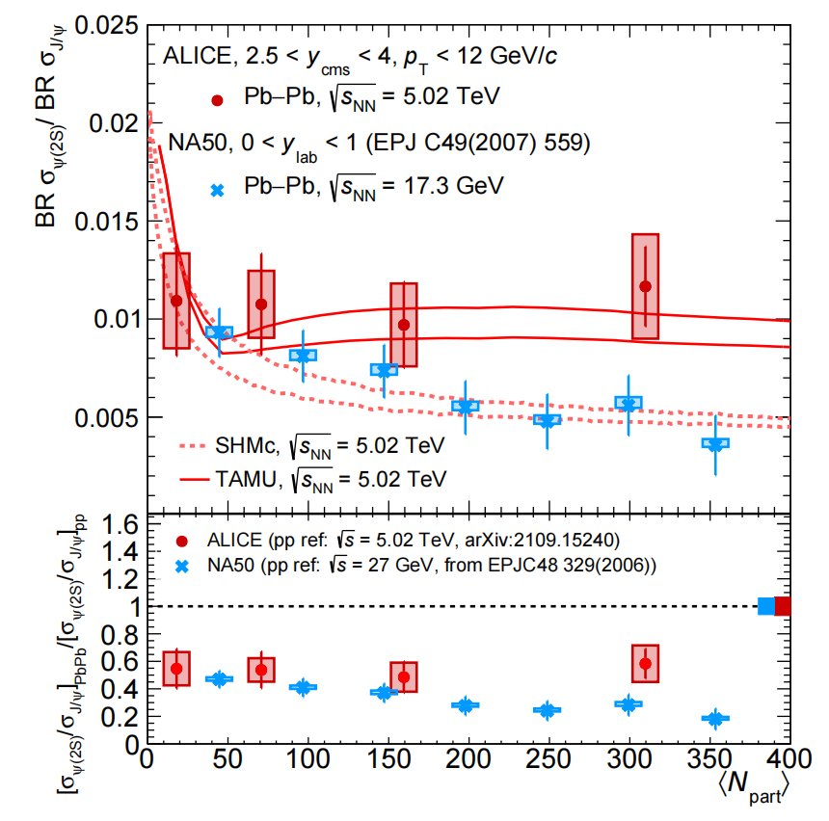
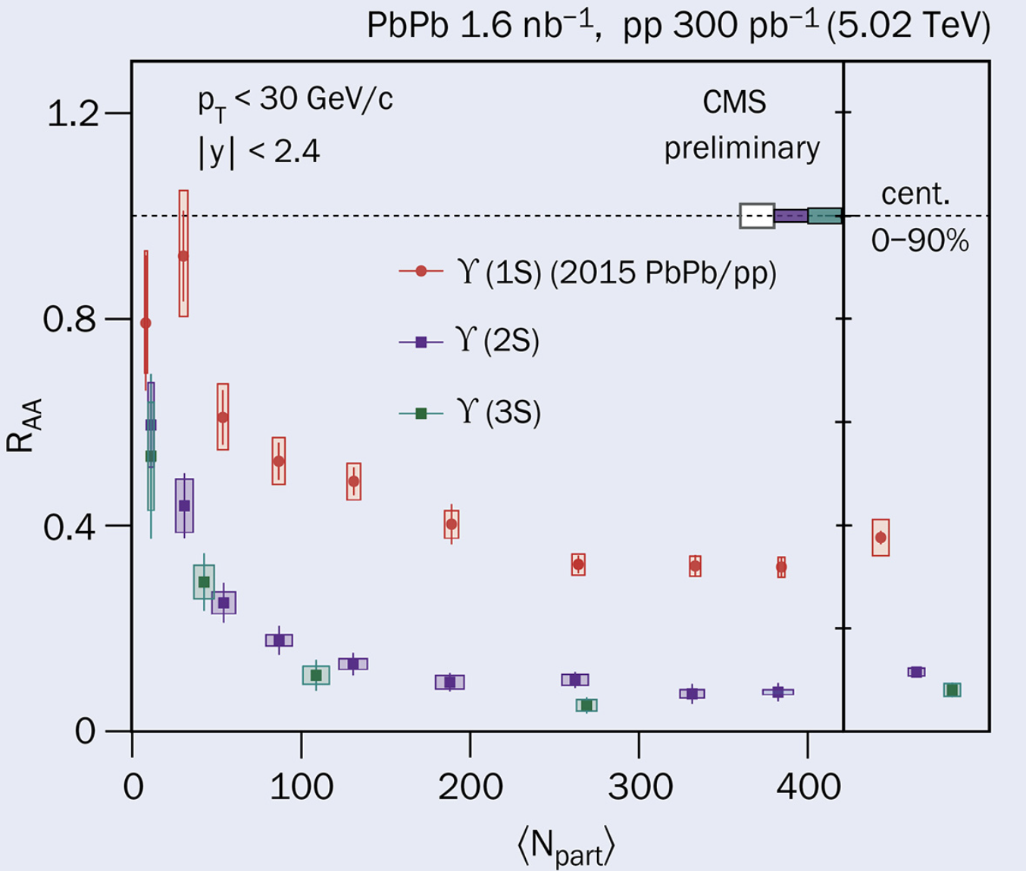

Result: $J/ψ, ψ(2S)$ and $Υ(nS)$
Production ratio in pp collisions decreases with multiplicity in CMS, no significant suppression found in ALICE
Possibly attributed to co-mover effects due to the relationship different rapidity range and pseudo-rapidity range
CMS-PAS-HIN-21-007
CERN-EP-2022-210
Multiplicity measured in: $−2.4<η<2.4$ $−0.9<η<0.9$
Production measured in : $−1.2<y<1.2$ $2.5<y<4$

Slide 9
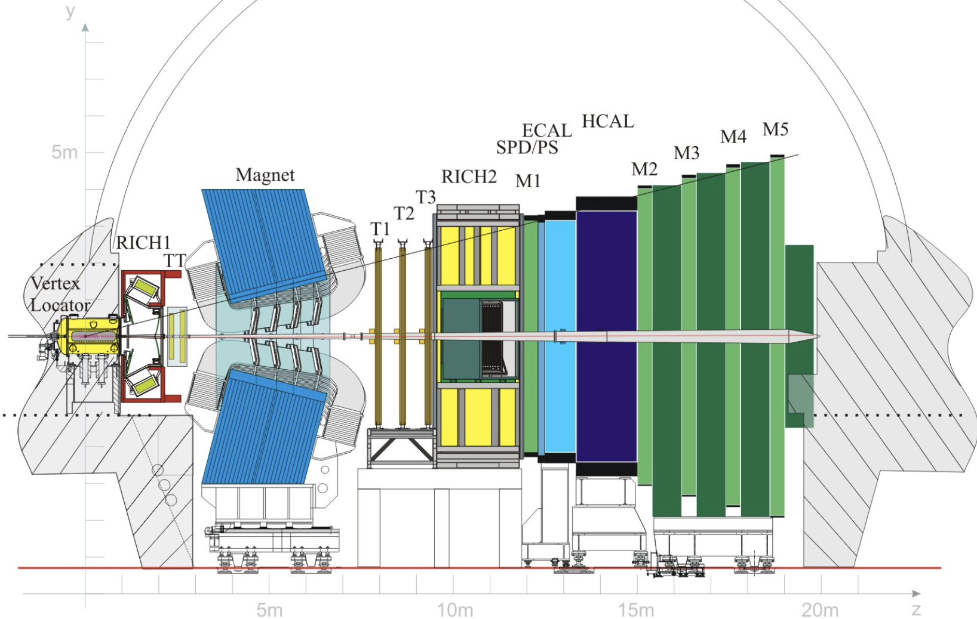
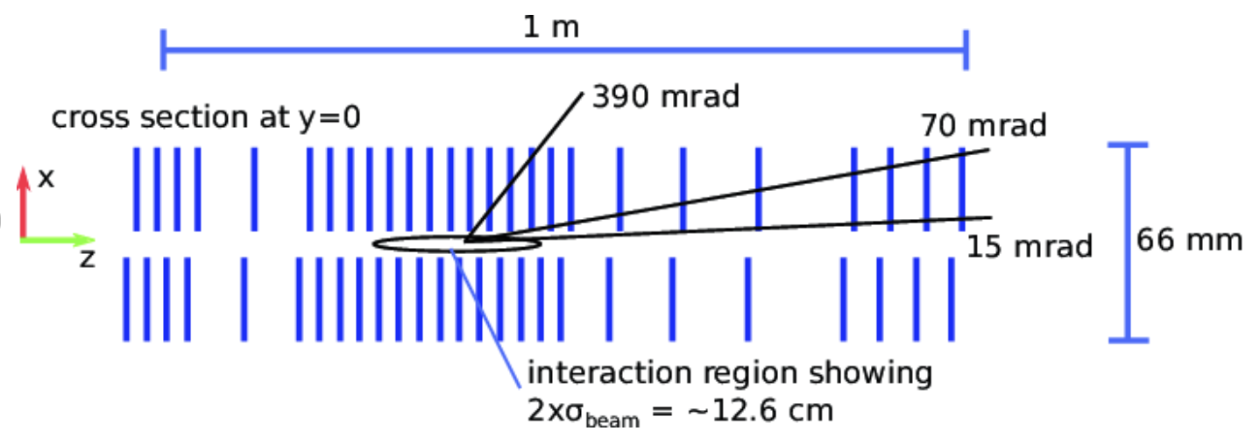
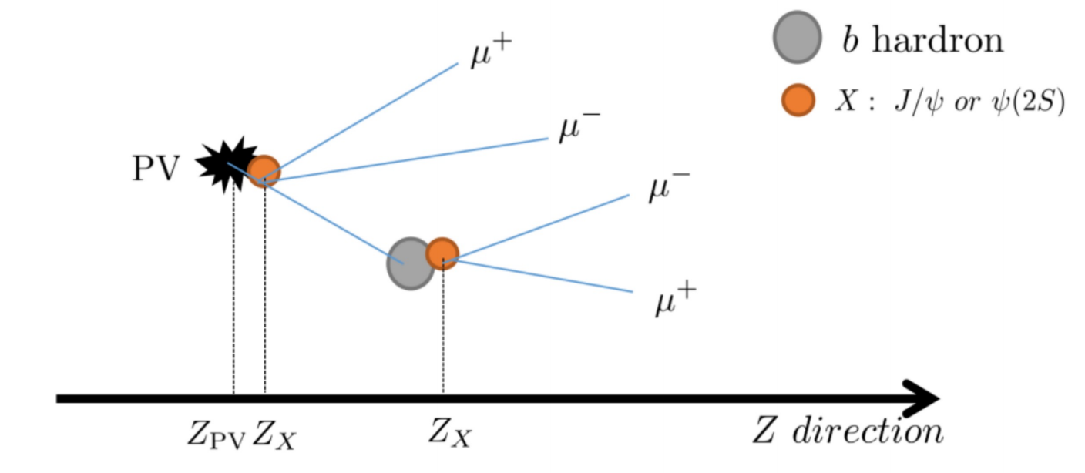
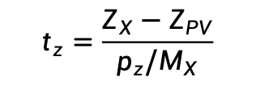
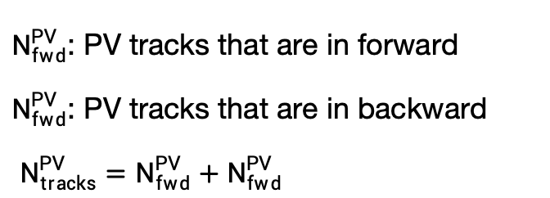
LHCb detector
A single arm forward detector designed for study heavy flavor
Play more important roles in heavy-ion physics
LHCb detector
Excellent muon detector
$N_{fwd}^{PV}$: PV tracks that are in forward
$N_{fwd}^{PV}$: PV tracks that are in backward
$N_{tracks}^{PV}=N_{fwd}^{PV}+N_{fwd}^{PV}$
$$t_{z}=\frac{Z_{X}−Z_{PV}}{p_{z}/M_{X}}$$

Slide 10
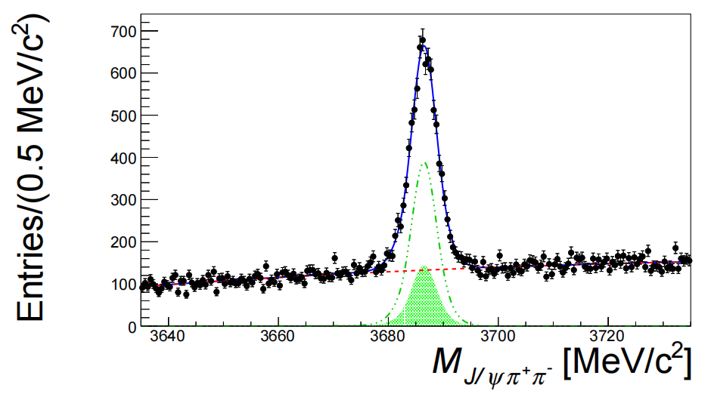
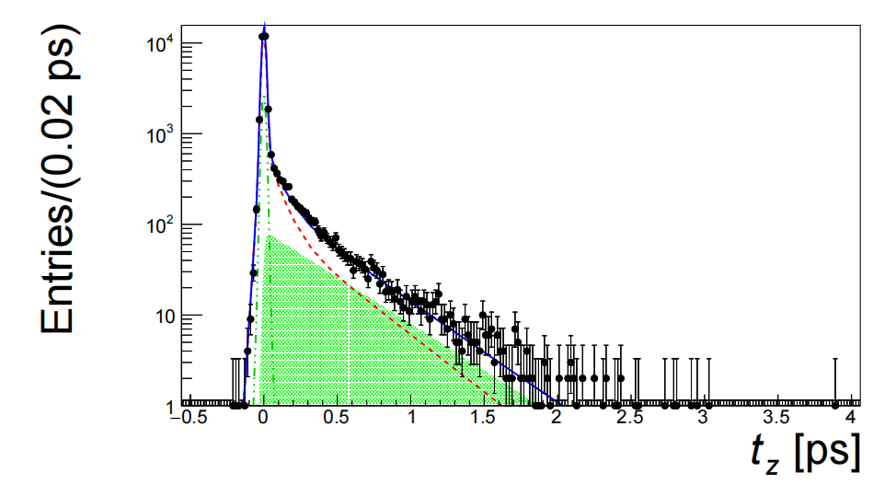
Signal extraction
Two-dimensional fit is performed to invariant mass and pseudo-decay time spectrum to extract prompt components, where
$$t_{z}=\frac{Z_{X}−Z_{PV}}{p_{z}/M_{X}}$$

Slide 11
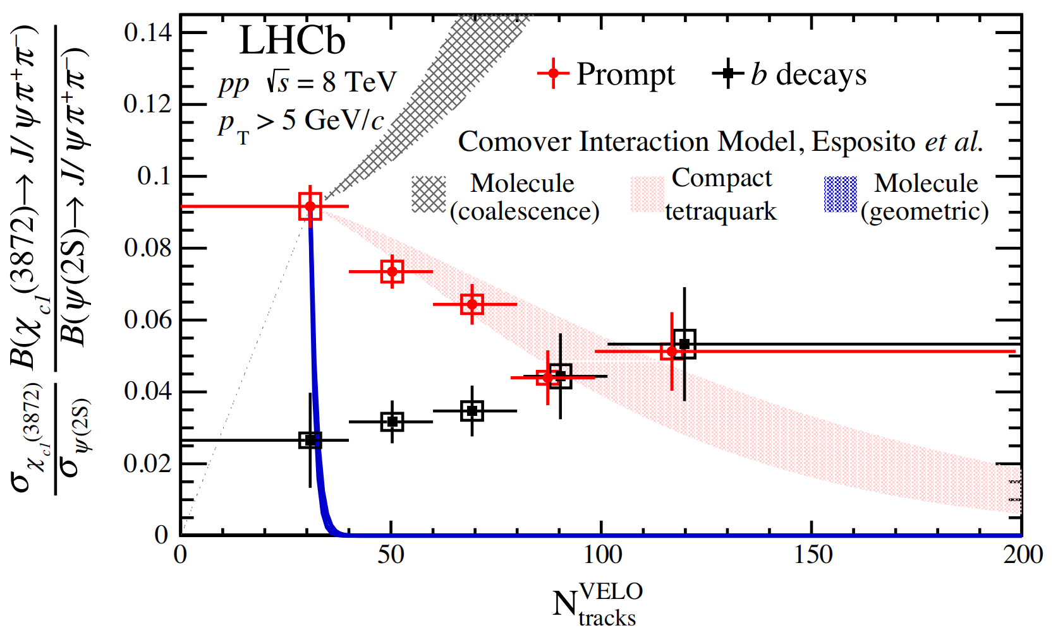

Result: $χ_{c1}(3872)/ψ(2S)$
Prompt ratio decreases with charged particle multiplicity, agreeing with co-mover hypothesis
PhysRevLett.126.092001

Slide 12
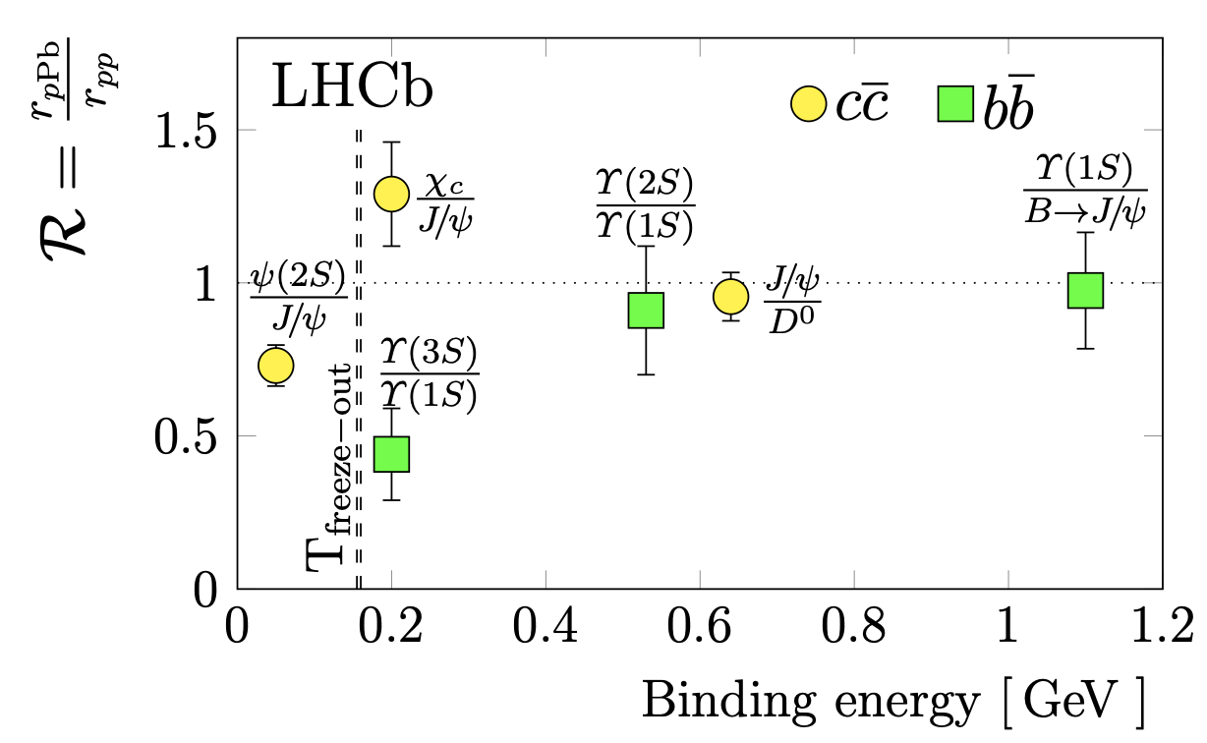
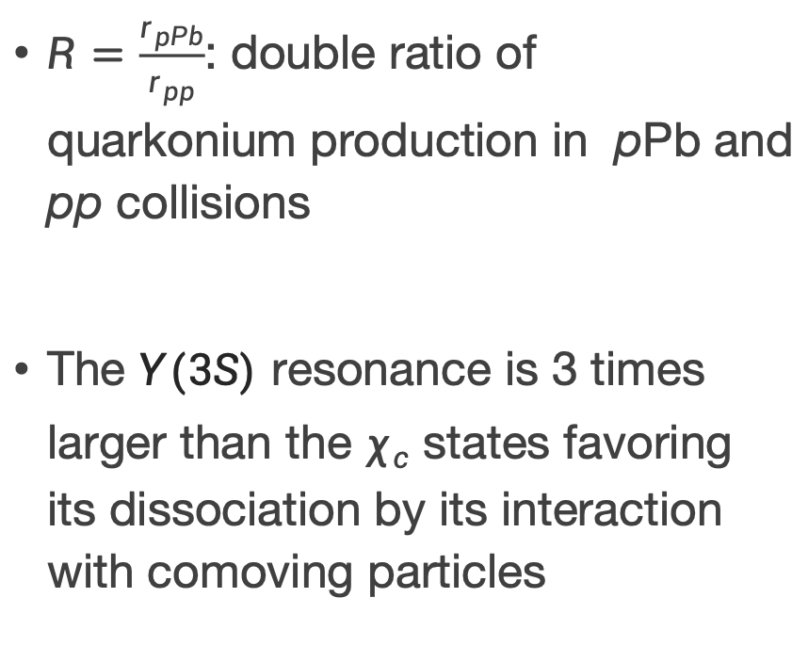

Result: $χ_{c}/J/ψ$
$R=\frac{r_{pPb}}{r_{pp}}$: double ratio of quarkonium production in pPb and pp collisions
The $Υ(3S)$ resonance is 3 times larger than the $χ_{c}$ states favoring its dissociation by its interaction with comoving particles
arXiv:2311.01562v1

Slide 13
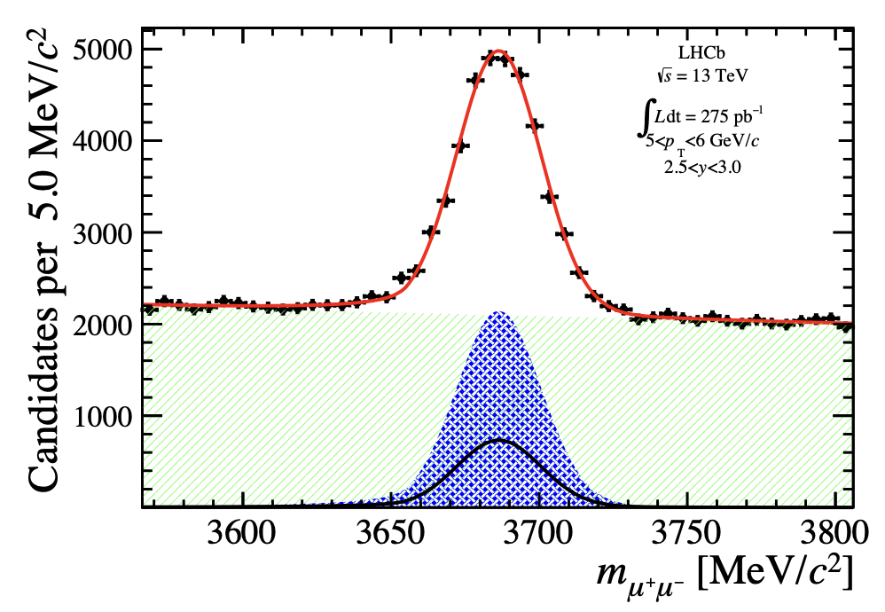
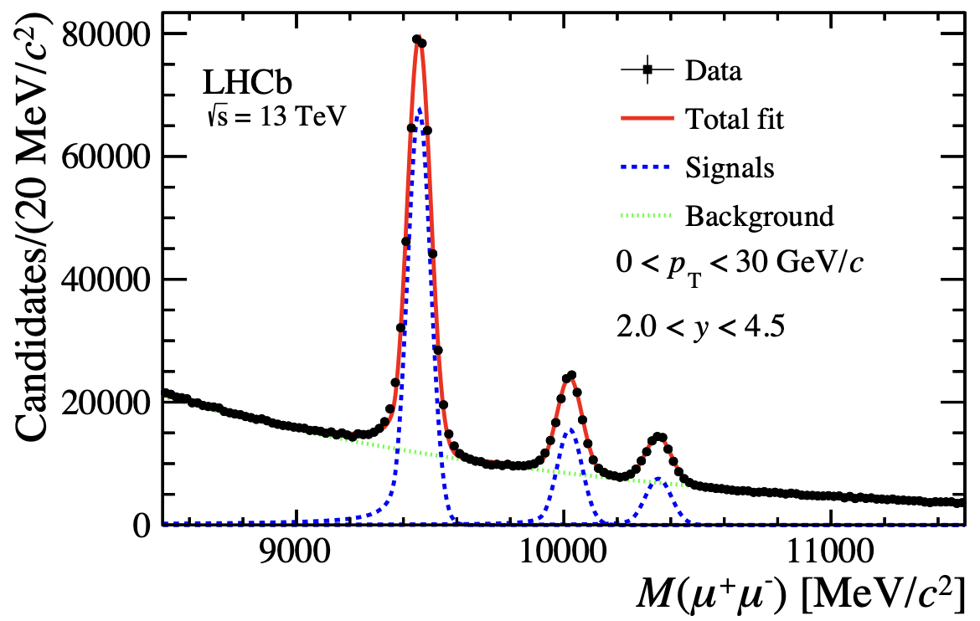
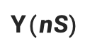
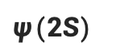
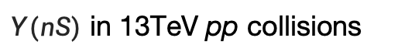
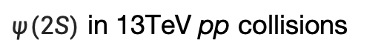
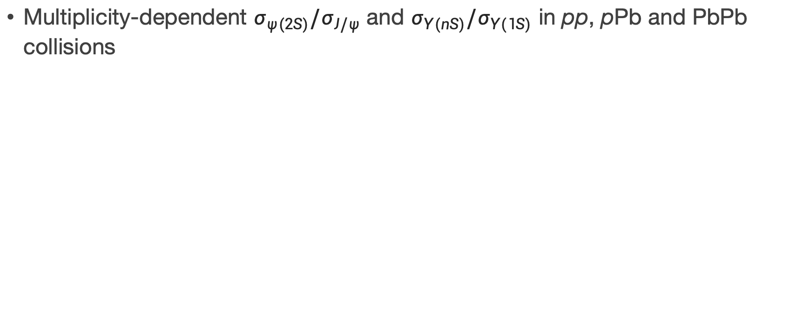
Ongoing analyses (in circulation)
Multiplicity-dependent $σ_{ψ(2S)}/σ_{J/ψ}$ and $σ_{Υ(nS)}/σ_{Υ(1S)}$ in pp, pPb and PbPb collisions
$ψ(2S)$
$Υ(nS)$
$ψ(2S)$ in 13TeV pp collisions
$Υ(nS)$ in 13TeV pp collisions

Slide 14
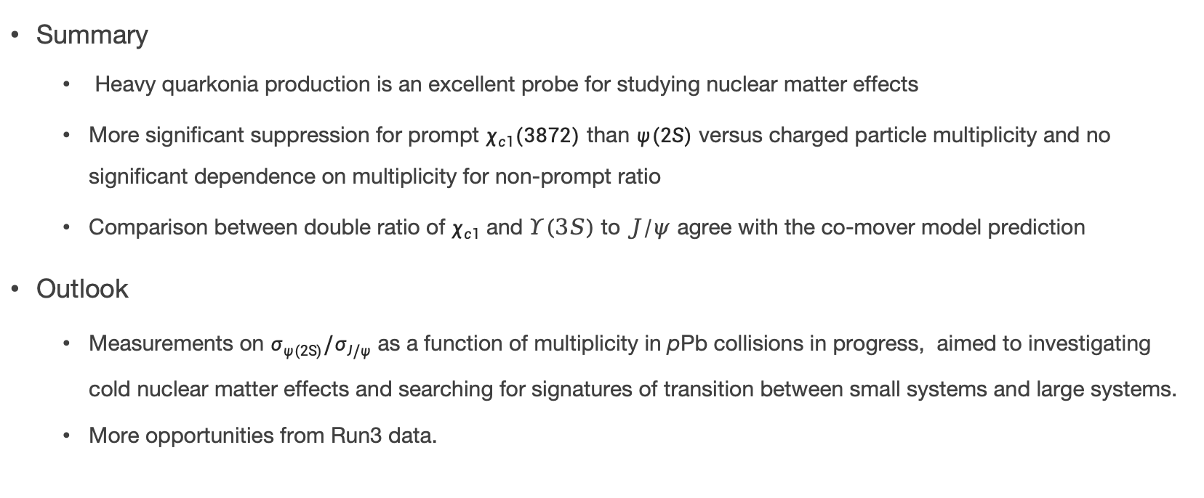
Summary & Outlook
Summary
Heavy quarkonia production is an excellent probe for studying nuclear matter effects
More significant suppression for prompt $χ_{c1}(3872)$ than $ψ(2S)$ versus charged particle multiplicity and no significant dependence on multiplicity for non-prompt ratio
Comparison between double ratio of $χ_{c1}$ and $Υ(3S)$ to $J/ψ$ agree with the co-mover model prediction
Outlook
Measurements on $σ_{ψ(2S)}/σ_{J/ψ}$ as a function of multiplicity in pPb collisions in progress, aimed to investigating cold nuclear matter effects and searching for signatures of transition between small systems and large systems.
More opportunities from Run3 data.

Slide 15
Thanks for your attention!

